Slide 1
6.07.22
Notes:
Welcome!
Joint New Life / Epicentre
1.5 hours, then Q&A after
Emphasis on housing
Show me your ballot / run and get it

Slide 2
Why Housing?
Why Local Politics?
Notes:
Local politics – area where we can effect most change, fewer voters = more impact of each voter, character and personality matter much more than political party, most often ignored for bigger, sexier races (president), most of the things that affect our lives happen on the local level
Housing - #1 issue affecting Los Angeles, everyone I’ve talked to in LA has had issues with housing, whether its homeless people living on the streets to low-income families get forced out of their apartment to college students living out of their cars to middle-class families who have to move out from their communities to afford a house. This is a systematic issue that touches every echelon of our society. We’re all affected, just in different ways.
Also structural issue that can’t be addressed just on individual or church-level. one church can’t just build housing (that’s illegal), need for systematic change and organizing to reverse the corrupt systems that exist and challenge powerful interest groups that benefit
Also a spiritual issue: Prophets talk about sin, always reference housing as a sin of idolatry. If there’s inequality, people too concerned about their own and not about their neighbors, what sly tricks that used to get their homes, can be quite judgmental - Amos 3:15 - I will strike the winter house along with the summer house, and the houses of ivory shall perish, and the great houses shall come to an end.
Not just a policy issue, but a spiritual issue. Because of how many people it affects, I would say it’s our city’s greatest sin

Slide 3
Ecclesiastes 5:8-9
If you see the poor oppressed in a district, and justice and rights denied, do not be surprised at such things; for one official is eyed by a higher one, and over them both are others higher still. The increase from the land is taken by all; the king himself profits from the fields.
Notes:
Frame before we go in: book of Ecclesiastes, very practical and sober-minded understanding of the world, also some hope
Passage tells us that corruption in government is inevitable, that there’s a hierarchy where people in power exploit those beneath them, all the way down to the poor, who have their rights and justice denied. There’s no one to help them. In fact, the king (the highest of highs, supposed to be champion of justice) benefits from this exploitation. They are a part of the system.
Cynical but accurate view of modern government. City as complicated as LA, lot of bureaucracy and red tape, created for a reason. People in power making it complicated for own gain (ask Tiff about working with city contractors). There are backroom deals, there’s corruption and embezzlement. Goes all the way to the top. Corruption is the norm.
BUT there’s also some hope: last verse, king profits from fields. What does that mean? People in power take a cut of what the common people produce. HOWEVER it means they are also dependent on the common people. Without the production of the common people, they can’t do anything, especially true in democratic society. Without our votes, without our support, those in power can do nothing. See how the Bible turns that upside down? Those in power need us far more than we need them. And if we as the common people organize, we can influence them towards real change.

Slide 4
PERMISSION SLIPS
Collaborative
Differing Perspectives
Informed, Not Perfect
Notes:
Permission slips – often these election conversations have certain rules: expert gives the info, usually skewed towards one perspective, and unless you follow their recommendations you’re a terrible person. Basically most church voter guides follow this idea. We want to do things different, give permission to break those rules.
Collaborative – we have some time/energy to do this, but everyone brings something to the table, each person has a unique perspective based on your background, where you live, where you work, who you know. Encourage you to share that. Will make time for that sharing.
Differing perspectives – not all politically the same, what unites us is that we are Followers of Jesus, but that can look very different and that’s okay. Like Thomas and I, are very pro-development of all forms of housing, others might be focused specifically on affordable housing, or protective measures like rent controls. Some people here might also be still on the fence, worried about homeless encampments and just wish cities would clean up the streets. Safe space to share honestly and openly.
Informed, not perfect – local politics is complicated, all these different offices and districts and judges, can be overwhelming. Easy to think: if I make the wrong decision, I’m going to hurt somebody. Reality is none of us have all the answers, can’t know everything. we can do what we can with the little that we have to try and affect change. Luke 16:10 – whoever can be trusted with little can also be trusted with much. Take what God has given you and make use of it.

Slide 5
Overview
06/07/22 election
Mayoral race – three main candidates
Open primary
Numerous key local offices
Affects critical issues

Slide 6
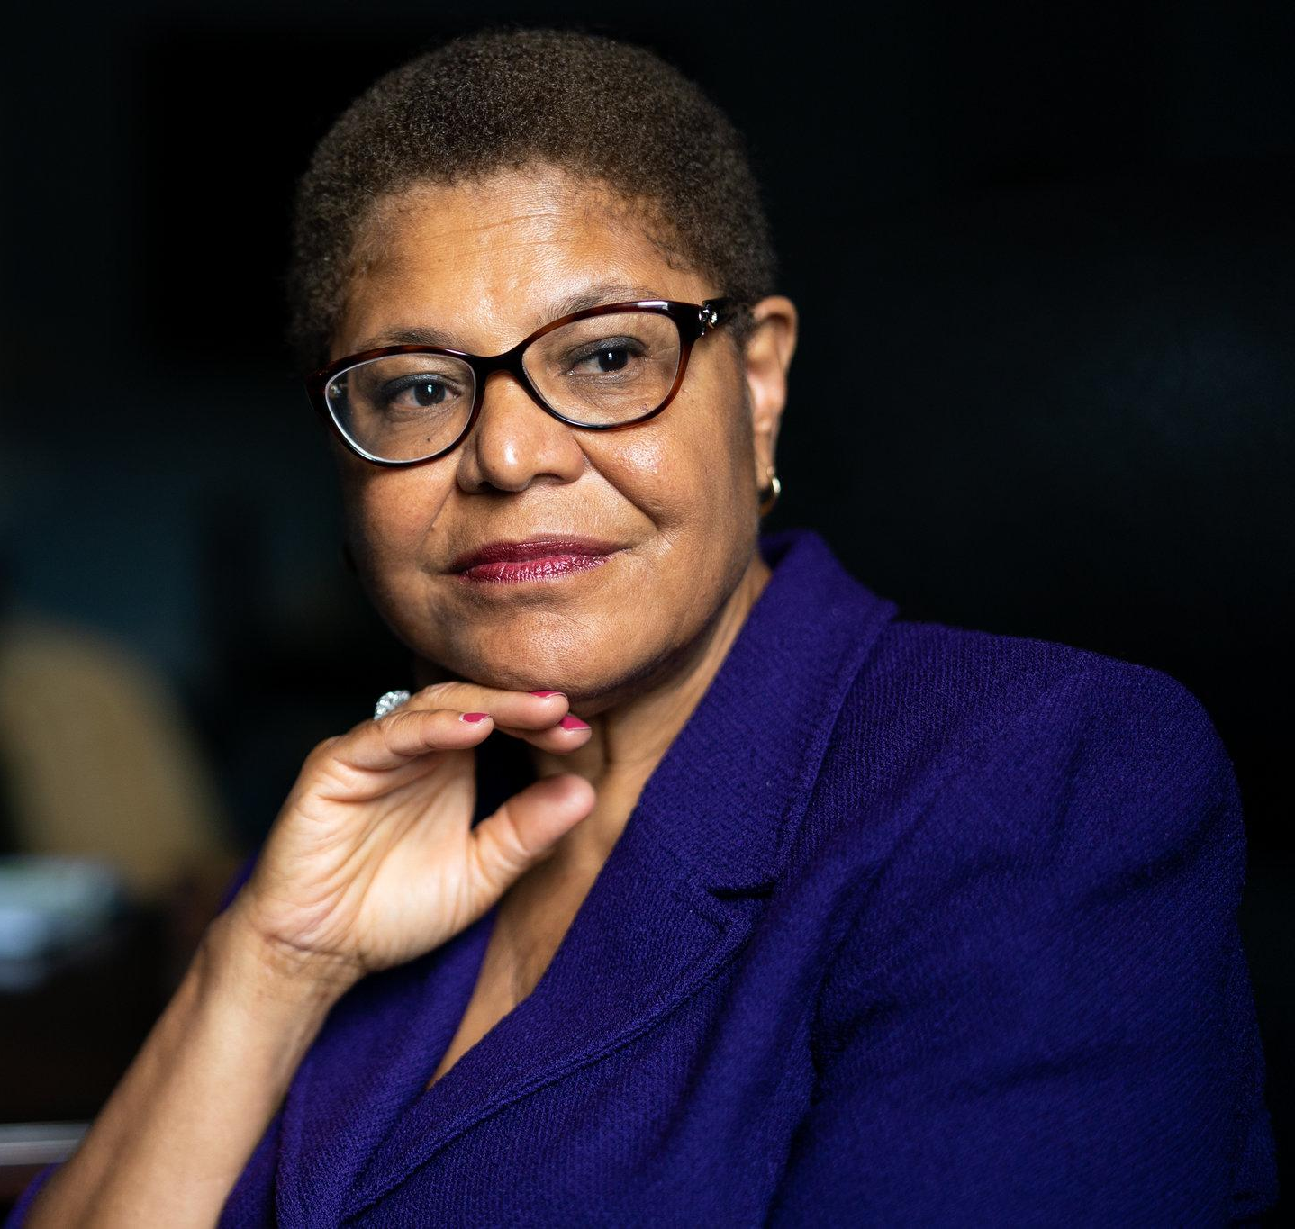
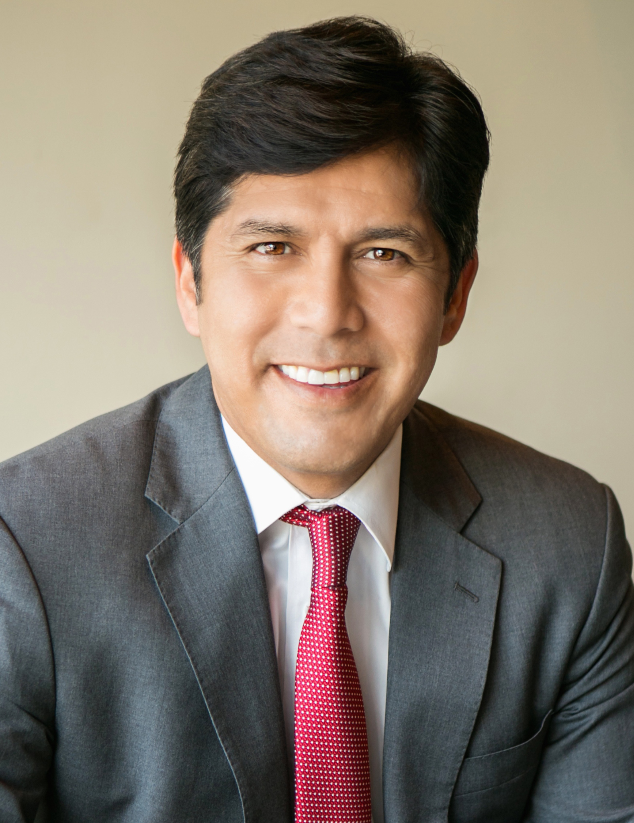
Mayor’s Race

Slide 7
Mayor’s Race

Slide 8
Mayoral Race – Discussion
What other information have you heard that wasn’t mentioned?

Slide 9
HOW TO VOTE IN LOCAL RACES
Determine what issues matter most to you
Find out what districts you belong to (https://votersedge.org/ca)
Figure out who endorses each candidate
Look at candidate’s website (optional)
Notes:
Local races – Love local politics because its where we can affect the most change. Places where you can actually build coalitions with neighbors to do good that you can actually see. Example, last neighborhood: toxic oil drilling site that placed right next to people’s houses. Our church worked with neighborhood groups, city council, etc. to get it closed down. Because local politics is not very popular, our representatives really listen to their constituents. They actually pay attention to individual voices, and that’s big.
Quick and easy guide, then do cheat sheet.
Determine what matters most to you, 3-4 key issues that you care about, or even one issue that is your dealbreaker. In this case, we’re looking at housing, because it affects so many people.
Figure out what districts you’re in and who you can vote for, use voter’s edge OR better yet, the actual ballot
Find out who endorses your candidate, because that tells you what they care about (ex. Abundant Housing LA for City Council 5), LA Times, Knock LA – not just who they support, but why. Assembling a piece of a puzzle where each group offers a part of the picture, and when you put the pieces together, you get a full picture
Candidate’s website – see how they brand themselves, inductive Bible study – making observations: what do they put at the forefront? Who’s endorsements do they emphasize? See trends of power structures: Planned Parenthood, Teachers Unions, Labor Unions, build a profile on them: Katy (progressive pro-choice mom), Sam Yebri (establishment democrat, big business, pro-Israel)

Slide 10
90012
 | City Council (1 & 13) | State Assembly (52) | State Senate (26)
Abundant Housing LA
CA YIMBY |  | Wendy Carillo
YIMBY Action
LA Times | Kate Pynoos (13)
Knock LA | Eunisses Hernandez (1), Hugo Soto-Martinez (13) | Mia Livas Porter
Notes:
Kate Pynoos – more experience with city hall, removing red-tape, smart policies: converting office buildings, LAUSD property, prioritizing ADUs, pre-fab constructions
https://www.kateforcouncil.la/plan-for/housing
https://www.hugo2022.com/#issues
Eunisses vs. Gil (identity politics, renter protections vs. market rate housing)
https://eunisses.com/platform/housing/
https://www.gilcedillo.com/house_la

Slide 11
90018
 | City Council (n/a) | State Assembly (55) | State Senate (28)
Abundant Housing LA |  |  | Lola Smallwood-Cuevas
CA YIMBY
YIMBY Action
LA Times
Knock LA |  | Isaac Bryan | Lola Smallwood-Cuevas
Notes:
Kate Pynoos – more experience with city hall

Slide 12
90022
 | City Council | State Assembly (52) | State Senate (30)
Abundant Housing LA
CA YIMBY |  | Wendy Carillo
YIMBY Action
LA Times
Knock LA |  | Mia Livas Porter | MCR or Henry Bouchot
Notes:
Wendy Carillo: https://www.wendyforassembly.com/accomplishments/
Mia Livas Porter: https://www.miaforassembly.com/vision/affordable-California (increasing supply, upzoning, vacancy tax: Thomas?), Ellis Act repeal – tenant protections

Slide 13
90025
 | City Council (5) | State Assembly (42 & 51) | State Senate (24 & 28)
Abundant Housing LA | Scott Epstein, Katy Young Yaroslavsky | Rick Chavez Zbur | Lola Smallwood-Cuevas
CA YIMBY |  | Rick Chavez Zbur
YIMBY Action |  | Rick Chavez Zbur
LA Times | Katy Young Yaroslavsky
Knock LA | Katy Young Yaroslavsky | Louis Abramson | Lola Smallwood-Cuevas
Notes:
Katy Young
Rick Chavez (Louis Abramson – b/c Zbur took corporate money)
Lola Smallwood-Cuevas

Slide 14
90034
 | City Council (5) | State Assembly (51 & 55) | State Senate (28)
Abundant Housing LA | Scott Epstein, Katy Young Yarovslavsky | Rick Chavez Zbur (51) | Lola Smallwood-Cuevas
CA YIMBY |  | Rick Chavez Zbur (51)
YIMBY Action |  | Rick Chavez Zbur (51)
LA Times | Katy Young Yaroslavsky
Knock LA | Katy Young Yaroslavsky | Louis Abramson (51), Isaac Bryan (55) | Lola Smallwood-Cuevas
Notes:
Senate is district 24 & 28
Assembly is 42 & 51

Slide 15
90033
 | City Council (n/a) | State Assembly (54) | State Senate (26)
Abundant Housing LA
CA YIMBY
YIMBY Action
LA Times
Knock LA
Notes:
No challengers

Slide 16
90057
 | City Council (1 & 13) | State Assembly (54) | State Senate (26)
Abundant Housing LA
CA YIMBY
YIMBY Action
LA Times | Kate Pynoos (13)
Knock LA | Eunisses Hernandez (1), Hugo Soto-Martinez (13)
Notes:
Kate Pynoos – more experience with city hall, extensive housing platform
Gil Cedillo - https://www.gilcedillo.com/house_la, pro-market rate
Eunisses Hernandez – leans heavily into identity politics, tenant protections, anti-market rate housing

Slide 17
91801
 | City Council (n/a) | State Assembly (49) | State Senate (n/a)
Abundant Housing LA
CA YIMBY
YIMBY Action
LA Times
Knock LA |  | No endorsement

Slide 18
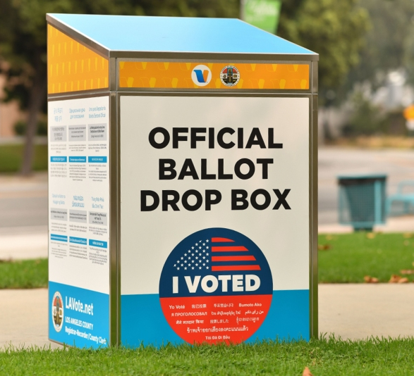
VOTER LOGISTICS
Notes:
Prioritize mail-in
Commitment to fill out
Commitment to deliver

Slide 19
What’s Next?
Notes:
Part of a broader effort called Faith and Housing Coalition
Partnership between New Life and Epicentre, especially after retreat, really wanted to create a ministry that addresses issue affecting all our churches
How body of Christ works on all
Regular email list – last minute requests regarding bills and stuff
Summer Life Group related to housing – explore biblical basis, barriers, and what we can do about it on individual, churchwide, and citywide level, check it out
Let’s take a picture!
Prayer

Slide 20
Q & A
Notes:
Other races
Judges etc.

